Slide 1
Methods and Arrays

Slide 2
Overview
Accessing methods from different files
Passing arrays to a method
Return arrays from a method
Primitive types as argument Vs Array as arguments
Parallel arrays

Slide 3
Accessing methods from different files
In some cases it is necessary to access methods located in different java files.
This can be helpful with general purpose methods (e.g. display methods)
In java this can be achieved using the following format
className.methodName(…)
Where
className is the name of the class containing the method
methodName is the name of the method.

Slide 4
Accessing methods from different files
The Java api makes extensive use of this functionality to simplify common tasks.
For example the Arrays utility class provides a lot of methods for performing common tasks with arrays e.g. Arrays.toString converts a given array to a string.
Some developers create their own utility classes that can be shared across a number of projects

Slide 5
Passing arrays to methods
When dealing with arrays of data, it is often necessary to pass an array into a method when modularising code.
This can help to reduce repetition and improve code clarity.
Arrays can be passed to functions in a similar way to other data types
Void average(int[] data)
In this example instead of a single integer value being passed the entire array is passed to method.

Slide 6
Return arrays from a method
Similarly an array can be returned from an array
Int[] myMethod()
In this case an array is returned to the calling code that can then be used.

Slide 7
Primitive types as argument Vs Array as arguments
When we pass a primitive data type as an argument to a method the value is “copied” into the method and can be safely changed without affecting the original variable.
This is not the case with arrays.
When we pass an array to a method the memory address of the array is passed in, thus we have access to the original array.

Slide 8
Primitive types as argument Vs Array as arguments
As the reference to the original array is passed to the function, the function can change the original array.
Because of this you should be careful about modifying the parameter as this can have unintended consequences for the rest of the program
Consider the example on temperatures over a seven day period where day 1 is in index 0, day 2 at index 1,…
Now lets say we write a method to find the median value.
If we are not careful how we treat the original array, when we sort the data in the function, the link between the temperature and the index is lost.
In this case we should create a copy of the array before sorting.

Slide 9
Parallel arrays
Sometimes we need to store multiple values of different types together.
Unfortunately arrays can only store one type of data
For example say we wanted to store a number of users names and ages.
As an array can store only one data type we cannot use them to store both
To overcome this issue we can use parallel arrays.

Slide 10
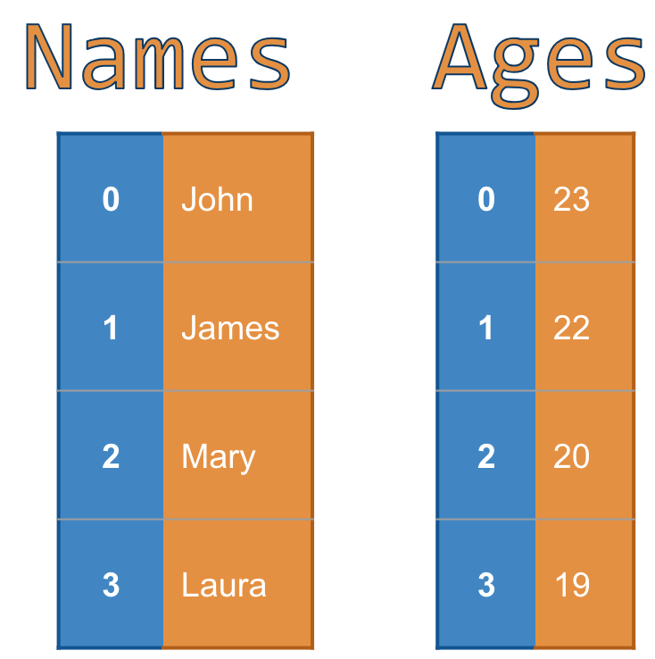
Parallel Arrays
Parallel arrays are where the data stored at a given index in one array is linked to the data at the same Index in another array
In the image opposite we can see
John is 23 (Both pieces of information at index 0)
James is 22 (Both pieces of information at index 1)
Etc.
Arrays used in this way can help create implicit data structures.

